Slide 1

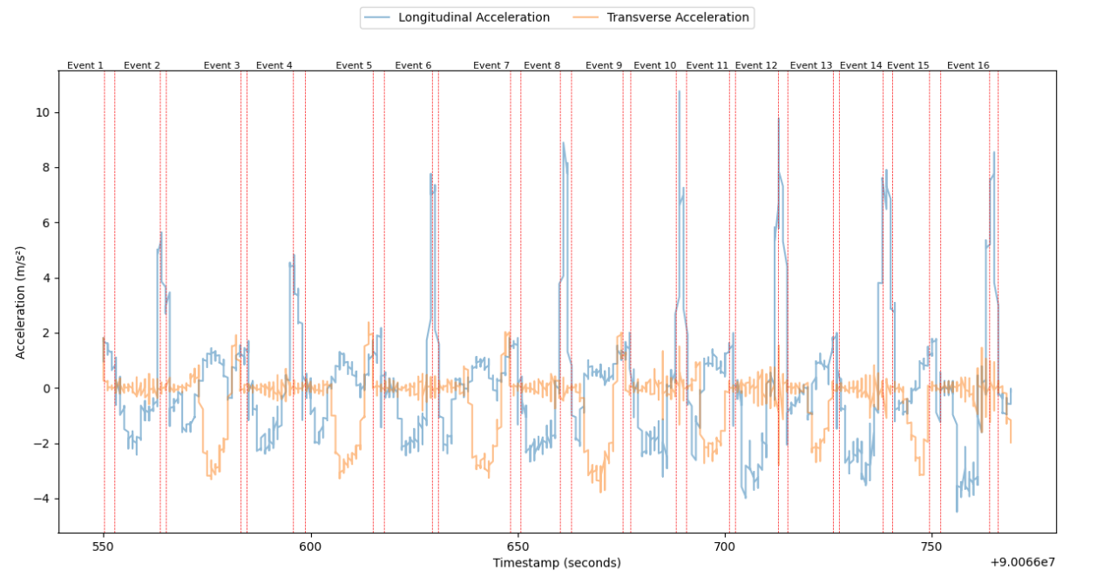
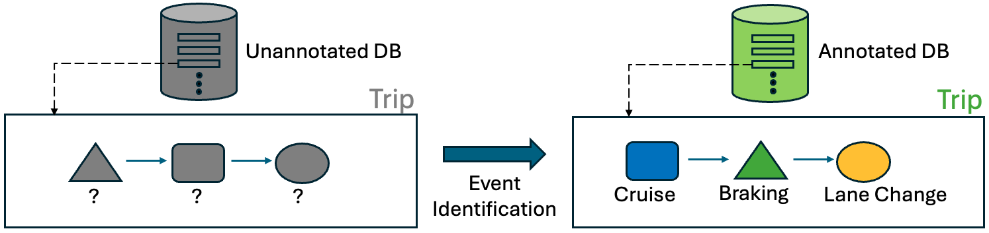
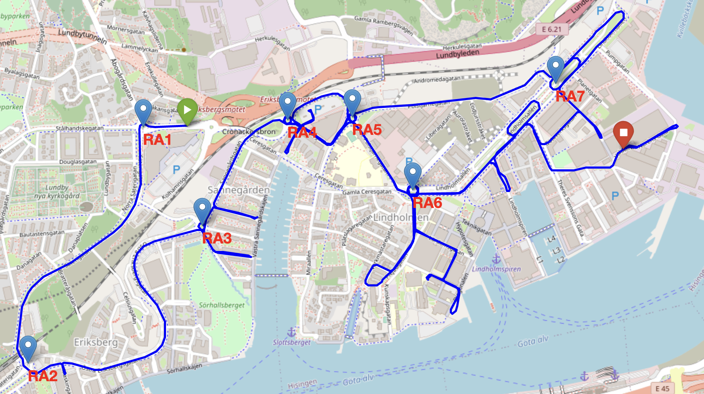
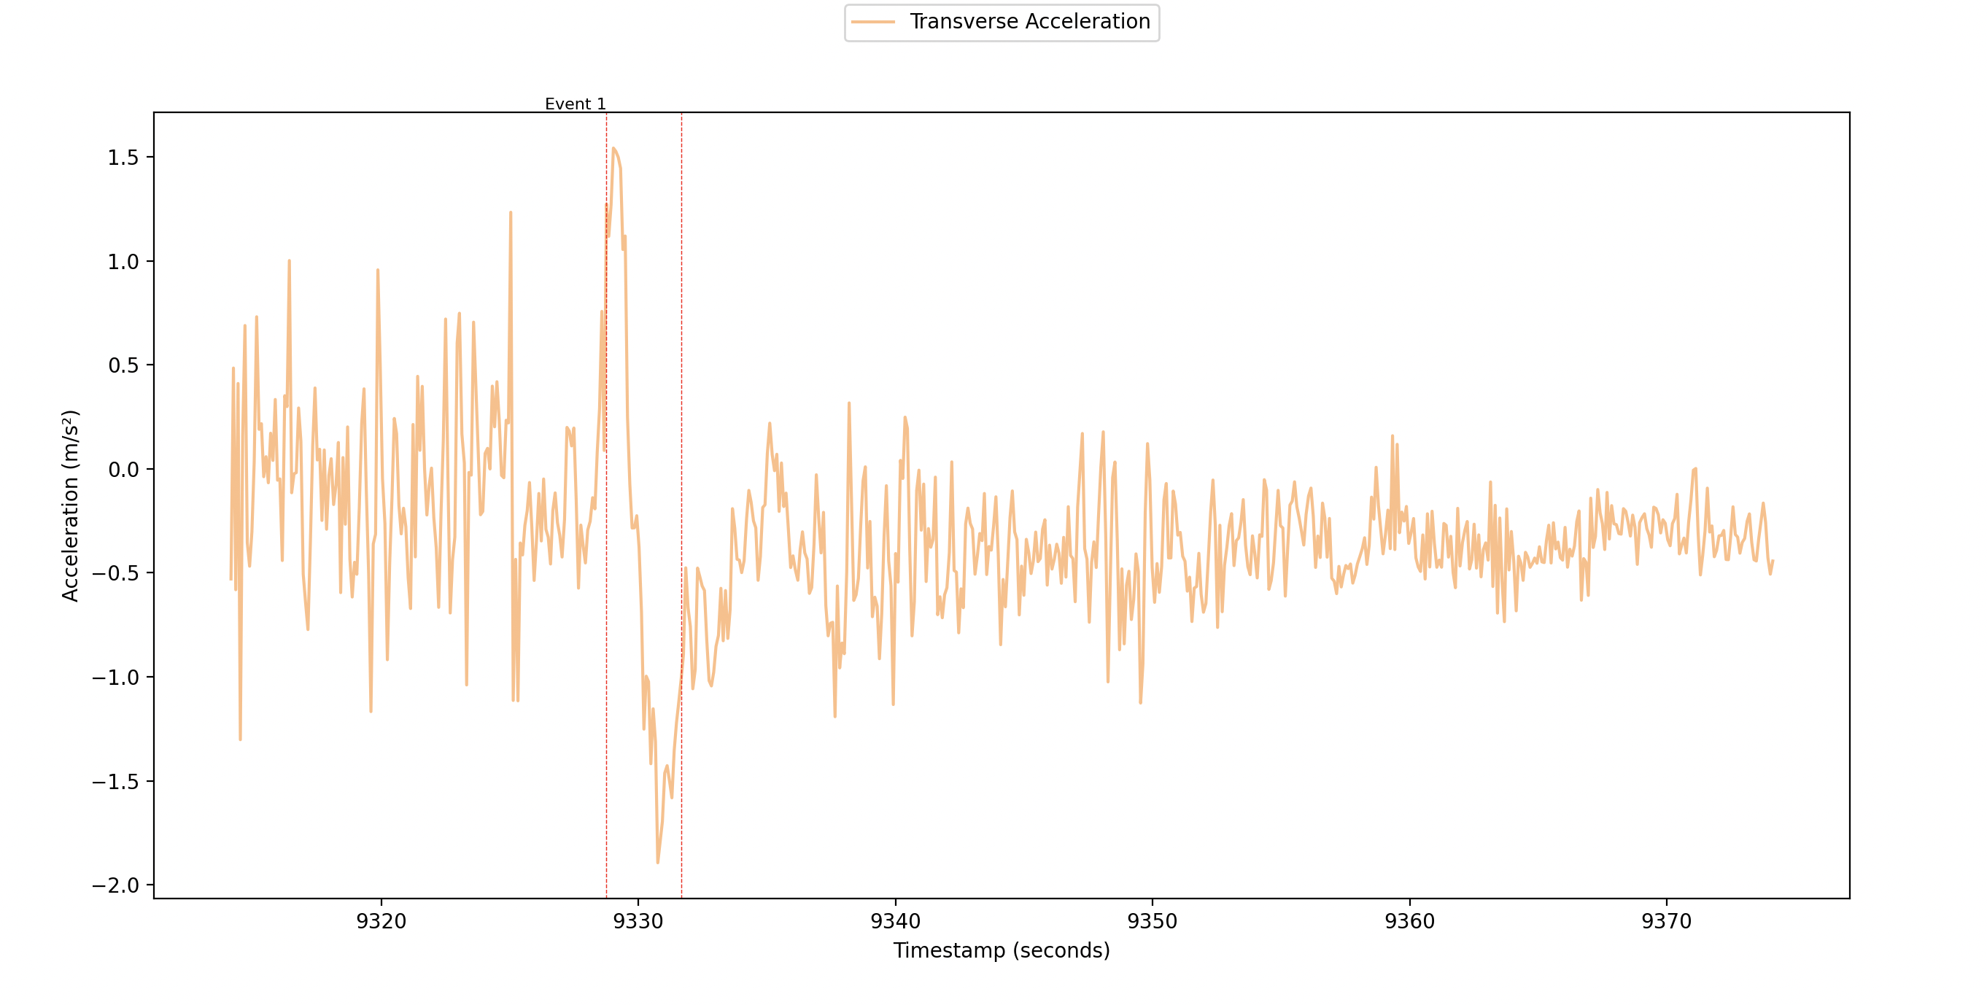
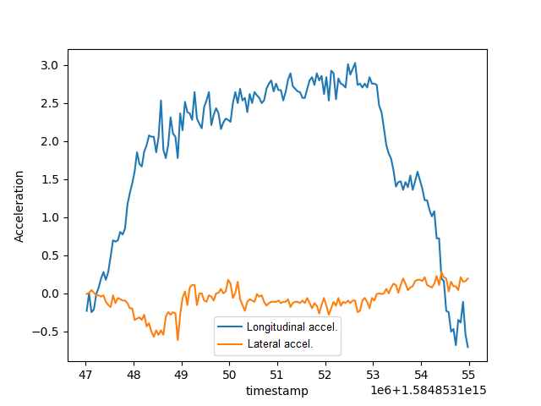
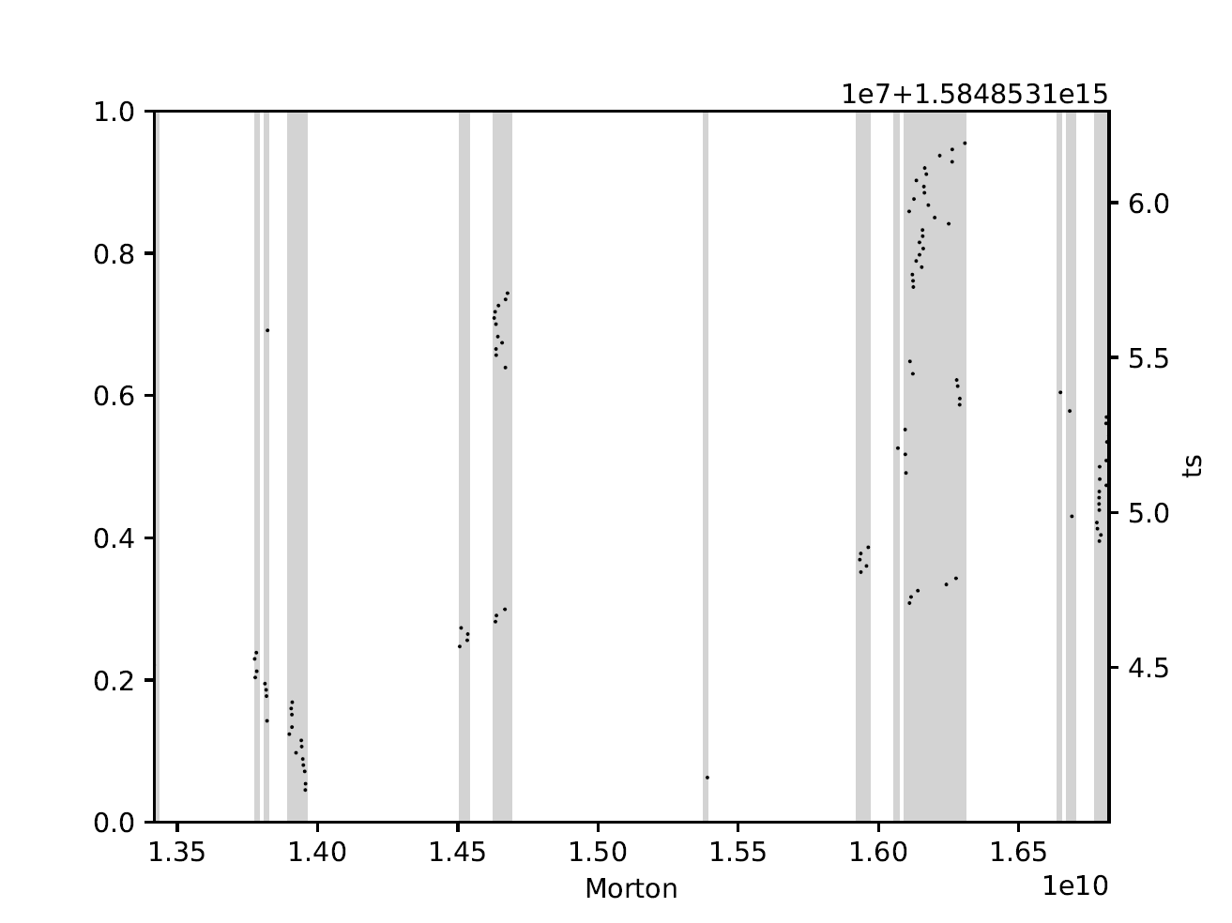
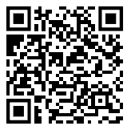
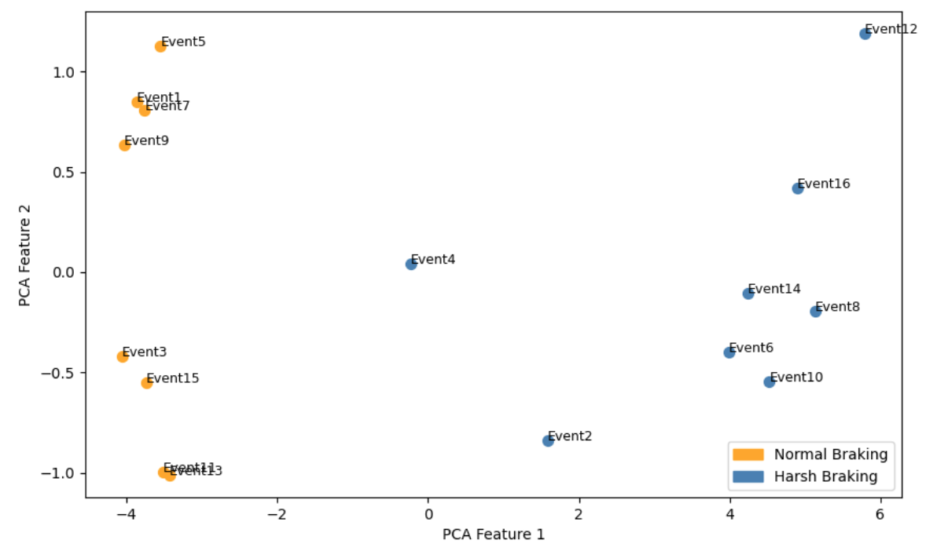
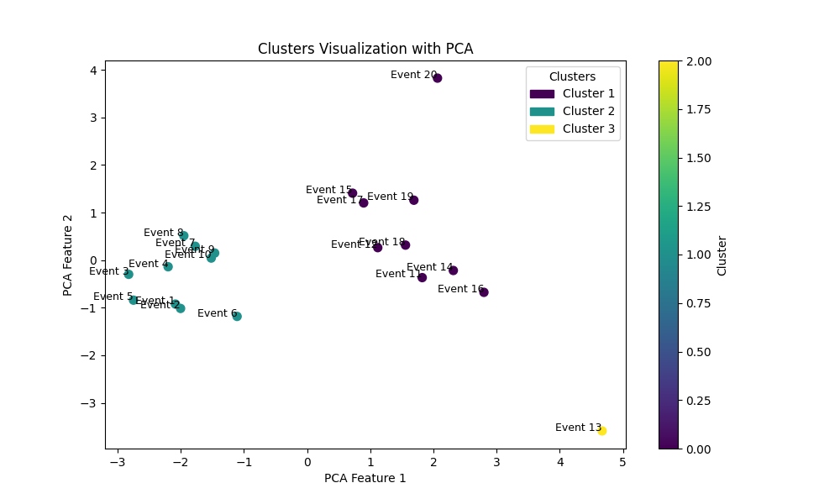
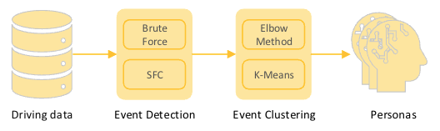

Efficient Exploration for Maneuver Identification in Automotive Data
M. Cagri Kaya Chalmers University of Technology
Department of Computer Science and Engineering
Abstract
The volume of automotive data collected by OEMs, technology companies, and researchers is continuously growing. However, much of this data remains un-annotated, with events during trips not labeled, which limits its utility. Annotated data is essential for monitoring driving behavior, assessing driver states, and training machine learning models. Given the scale of the data, manual annotation is time-consuming and resource-intensive. This study proposes an efficient method for detecting driving events using a limited amount of small-scale IMU and CAN data, while ensuring GDPR compliance by avoiding the use of cameras and GPS.
Why is annotation needed?
Braking events
Large-scale field data is un-annotated → less useful
Identifying maneuvers, driving events, during a trip makes data useful:
On-board: to monitor driving and driver states
Off-board: to train and evaluate ML algorithms
Braking events can be detected using longitudinal acceleration.
Lane change events
Roundabout events
Lane change events can be detected using lateral acceleration.
We are using the public comma2k19 [2] dataset for experiments.
Efficient detection of roundabouts in a trip using a combination of:
- Longitudinal, lateral, vertical acceleration
- Steering wheel angle
- Yaw, pitch, roll rate
- SFC algorithms: Morton / Hilbert
Published [1]
Case study: event clustering
Clustering the same kind of events can indicate different types of driving behavior.
References
Berger, C., Cabrero-Daniel, B., Kaya, M.C., Darestani, M.E. and Shiels, H., 2023, September. Systematic Evaluation of Applying Space-Filling Curves to Automotive Maneuver Detection. In 2023 IEEE 26th International Conference on Intelligent Transportation Systems (ITSC) (pp. 2932-2938). IEEE.
Schafer, H., Santana, E., Haden, A. and Biasini, R., 2018. A commute in data: The comma2k19 dataset. arXiv preprint arXiv:1812.05752.
Different driving styles is an input for persona development in requirements engineering.

